Slide 1
Data and Research –
Traditional Principles
vs. Intervention, Reflection, and Accountability

Slide 2



Slide 3
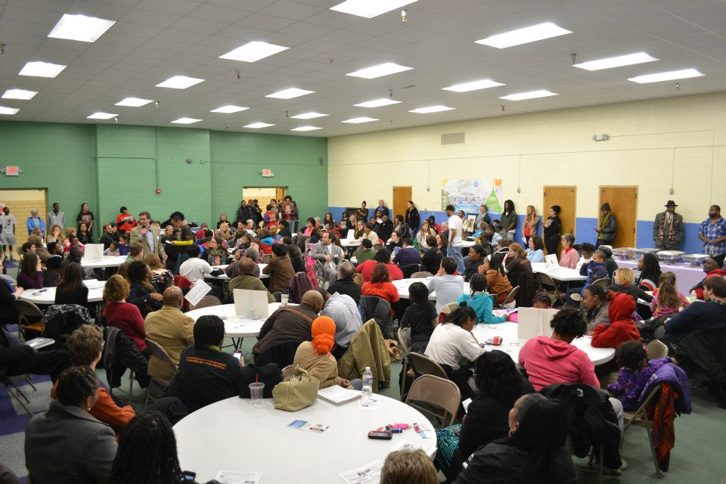
Network Nite – (next Thursday)

Slide 4
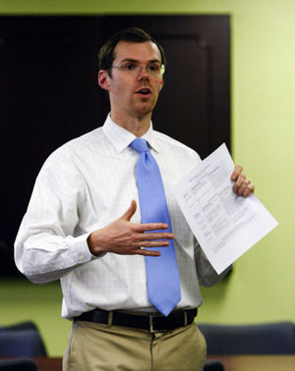
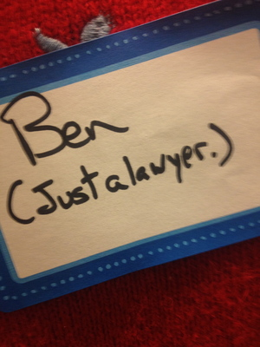

Slide 5
outline
Principles in Data and Research
Tax Liens and Policy
Community Engagement
Discussion

Slide 6
Principle 1 -- [on positionality]
We reject singularity. In place of the pursuit of certainty in generating representations of the world, there is recognition that the world is so textured as to exceed our capacity to understand it. Thus we accede that our methodologies will be characterized as much by openness, reflexivity and recursivity as by categorization, conclusion and closure.
Davies, G and Dwyer, C. 2007. Qualitative methods: are you enchanted or are you alienated? Progress in Human Geography 31(2). 257–266.

Slide 7
[on positionality]
“Knowledge is valid when it includes as acknowledgment of the knower’s specific position in any context…” – FA Maher
Persons
The Network
Community
Policy Makers

Slide 8
Principle 2 -- [on people]
We acknowledge the importance of relationships in our work.
Research has a troubled lineage of prioritizing the cognitive over the emotional, the generalized over the individual, and the controlled environment over the affective dimensions of a changing landscape. In effect, data collection usually denotes ‘feeling as thought’ or ‘thought as felt’, devalues the personhood of the researcher and dismisses the living interrelating continuity and practical consciousness of a community member / activist who also conducts research ³. While there are recognizable tensions inside of a feminist non-representational theory, we believe that our network has the capacity to navigate such tensions in order to treat ‘agency as both emotional and embodied’ for both the individual and the network at large ⁴. From this perspective we treat our personal data as important data, our vested struggles as important struggles and our neighborhoods’ interests as justified topics of investigation.
Law, J. 2004. After method: mess in social science research. London: Routledge

Slide 9
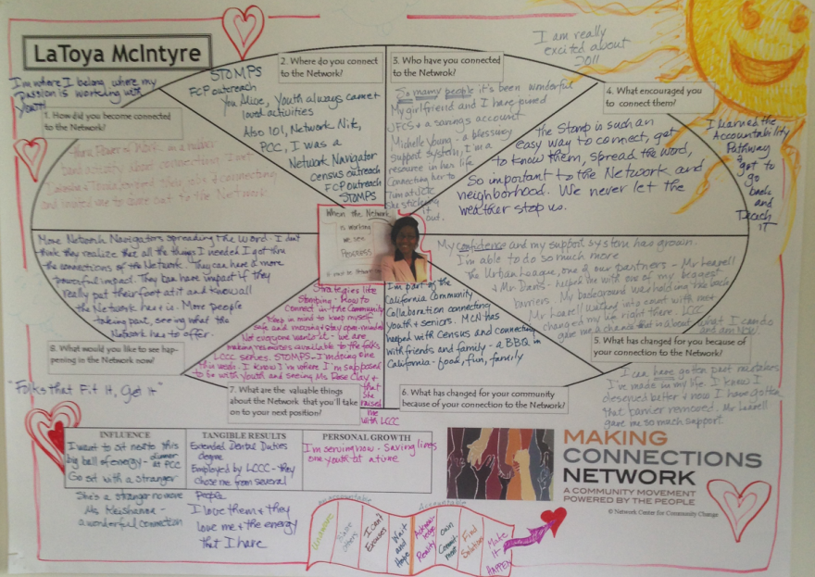
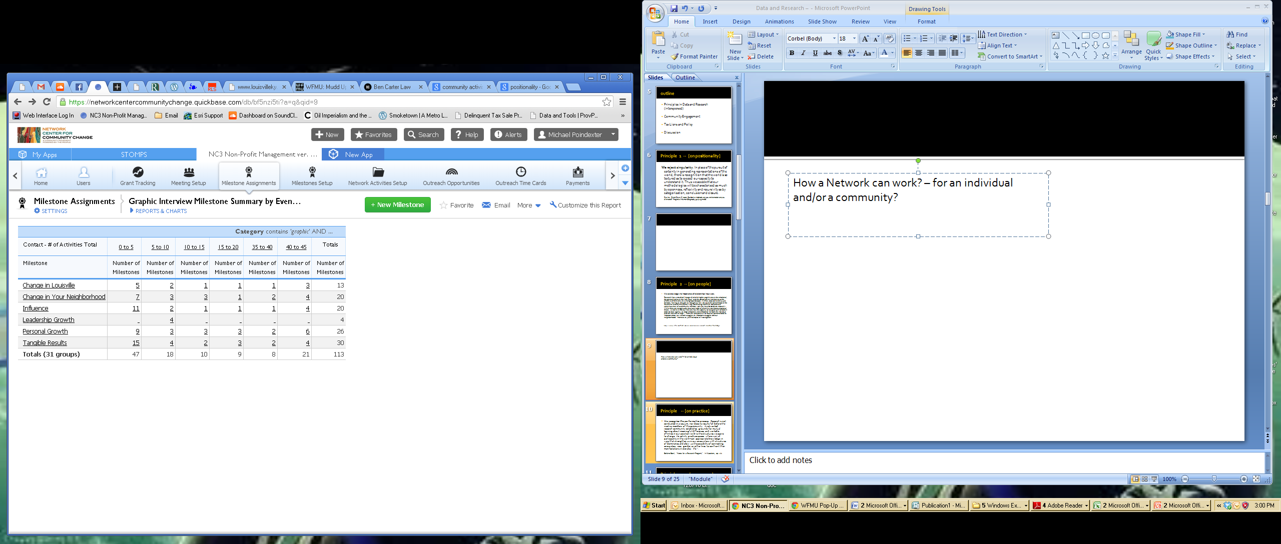

How a Network can work?
– for an individual and/or a community?

Slide 10
Principle – 3 [on process]
Our mode of inquiry is directed by and accountable to our network. While being committed to a socially just, equal and fair society we belief that knowledge is not disinterested, apolitical, naively found (discovered, uncovered, etc.), nor devoid of affective and embodied aspects of human experience. However, instead of taking a constantly ‘oppositional’ stance, we endorse a conception of inquiry that is at once ‘scientific and critical, rigorous and heterodox, structured and patchwork’ thereby avoiding the extremes of a unified normal academic science on the one hand, and the endorsement of just-about-anything-goes pluralism on the other ⁵. Above all we are passionately committed to our network and the community we live in.
Schwandt, T. 2011. Opposition Redirected. International Journal of Qualitative Studies in Education. 19:6. 803-810.

Slide 11
Principle 4 -- [on practice]
We recognize the performative process. Research is not conducted in a vacuum, nor does its results fall before the inactive members of the community. A networked research community establishes grounds for mutual learning about meaningful differences and workable affinities in our position vis-à-vis the structures we aspire to change. We activity produce spaces where we – all participants in the work – can appropriate knowledge in ways that strengthen us in our encounters with structures of dominance, and allow us the possibility of connecting across class, race, gender, or other lines to confront their manifestations in everyday life ².
Stefano Boeri, "Notes for a Research Program," in Mutations, op. cit.

Slide 12
LOKL
Who’s involved
Some Background
Policies
Data Source

Slide 13
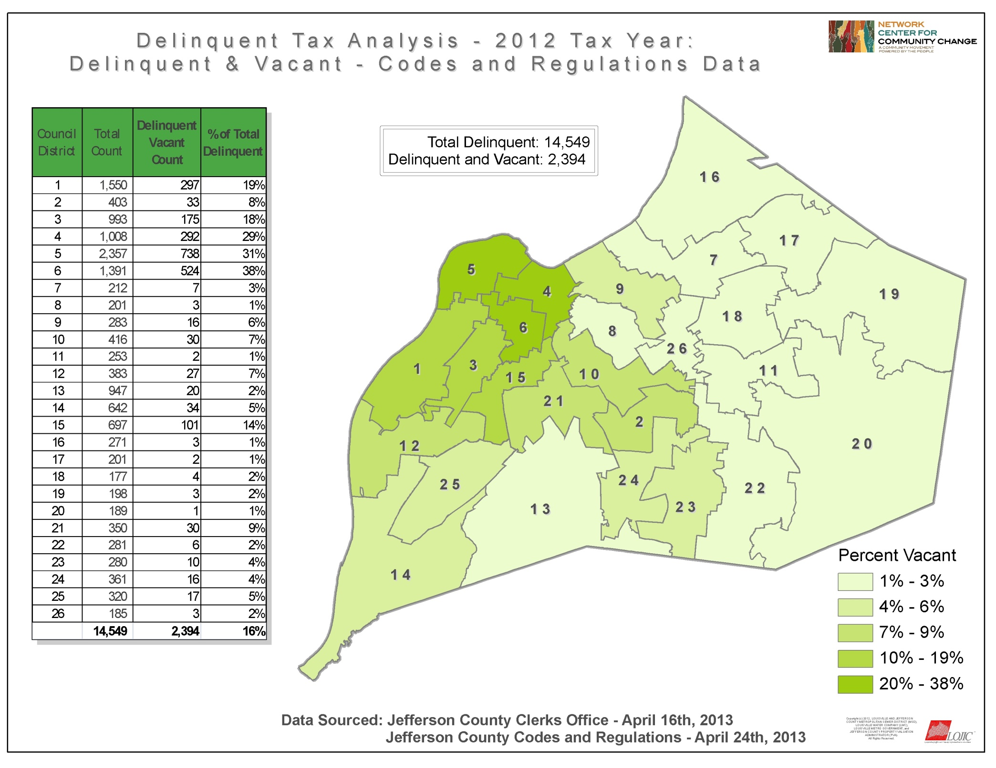

Slide 14
All Bills
Liens Sold to a 3rd Party
Buying liens post Commissioner Sale seems to be an uncommon practice.
Only 3 companies have made a point to buy more than one lien after July 18th.
209 Liens have been sold to 3rd parties on tax bills that originally had payment plans.
All of these purchases have taken place after the July Commissioner Sale.
198 (95%) of these have been purchased by a single party – DETCO.
Paul Blair purchased 9 and KY Liens Holdings purchased 2.
The Sale Amount had a difference rate that ranged from 167% to –85% to the original Bill Total. This amount can be negative because the lien is on what is left to be paid.
Payment Plan Bills
Total 407
DETCO seemingly has sought after liens on bills that formerly had payment plans;
79% of the liens that they purchased since July have been on these bills.
It is possible that DETCO believes there is a higher rate of receiving payment since bill holders have already made payments toward the bill.
DETCO

Slide 15

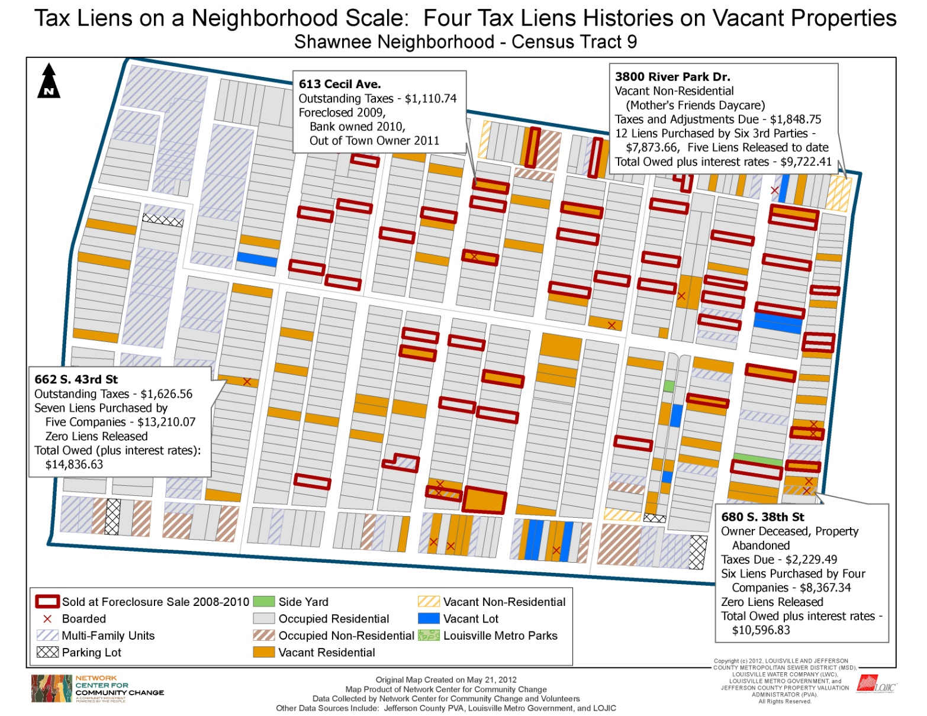
Shawnee is an historic residential neighborhood in Metro Council District 5.
369 of 3514 occupied residencies (10.5%) had delinquent taxes in 2011.
160 of 389 (41%) vacant residencies had delinquent taxes in 2011.
Owners of vacant property are less likely to pay property tax.
Vacancy data sourced by the Network Center for Community Change, Community Engagement Mapping , 2012.
Four properties in a small section of Shawnee

Slide 16
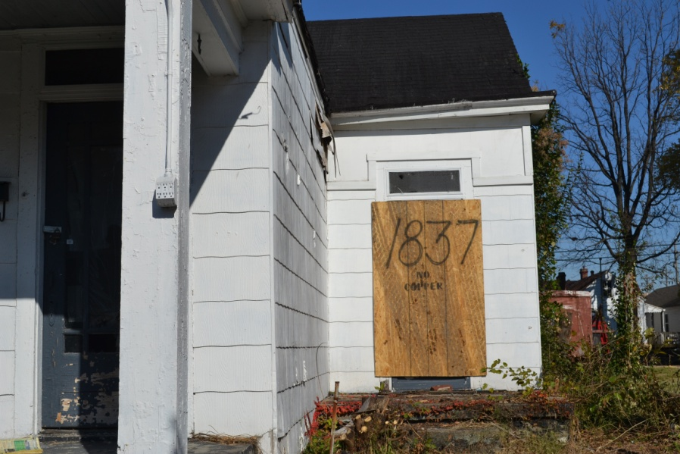
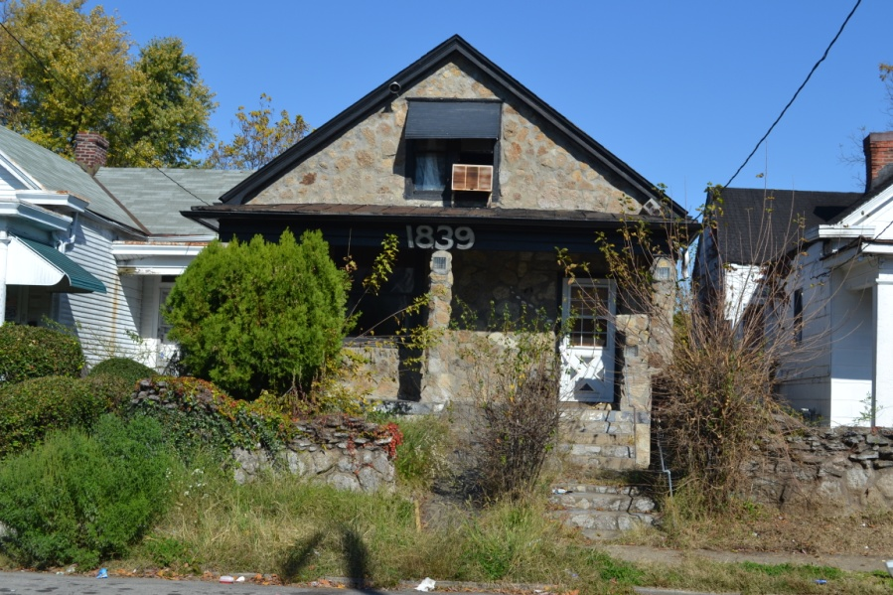
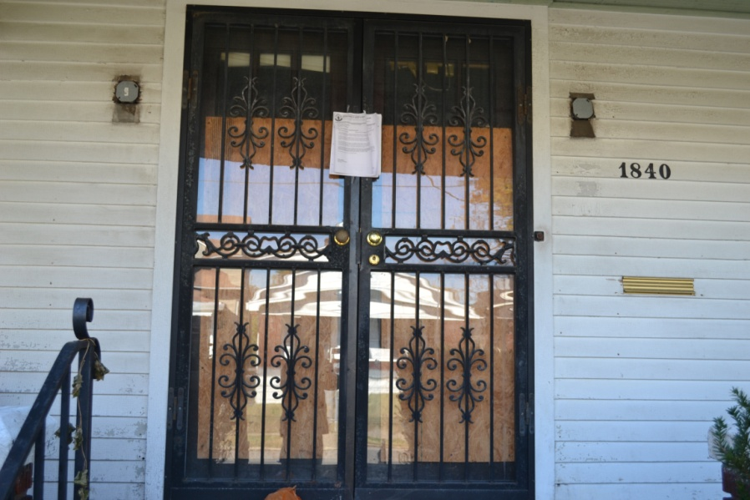
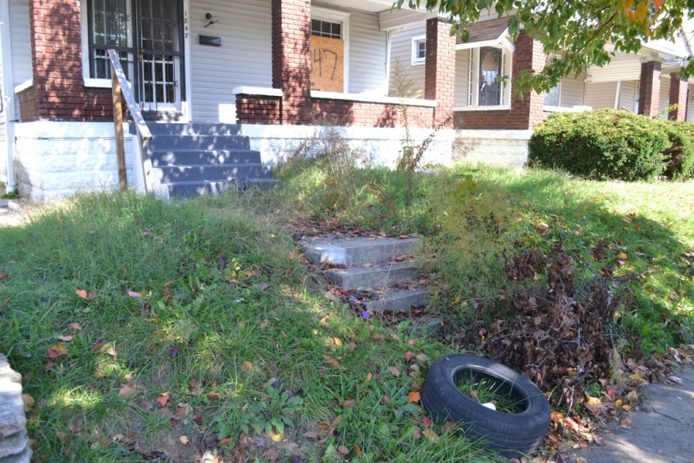
Vacancy and Housing Quality : Creating Our Own Data

Slide 17
Community Engagement Mapping Projects
California (section of) -- 2010
Portland (section of) – partnered with Habitat – 2011
Shawnee – 2012
Smoketown – partnered with LMHA – 2012 / 2013

Slide 18
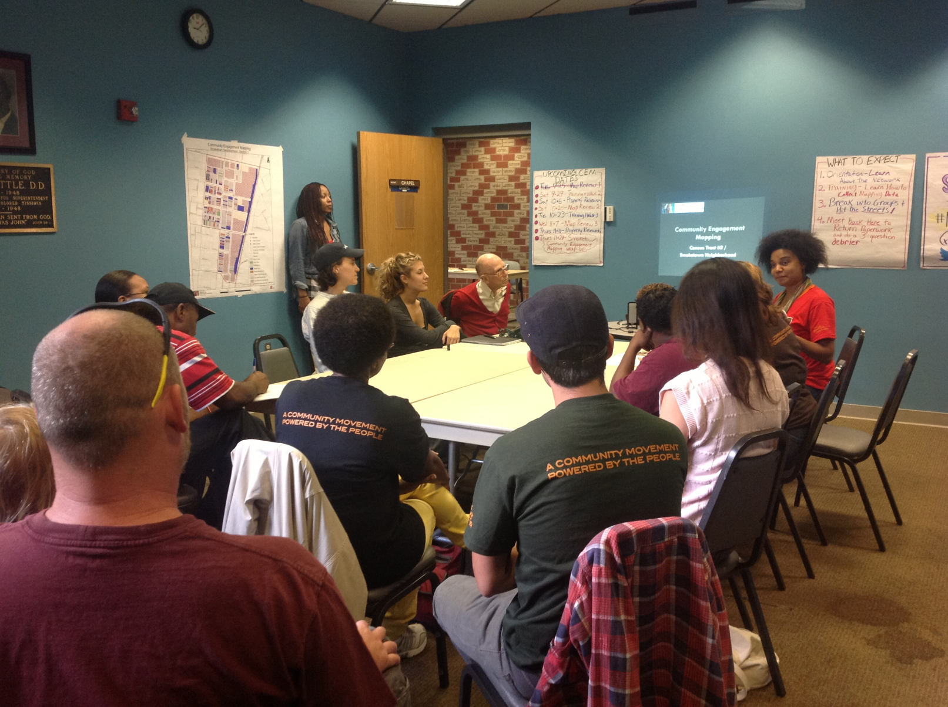

Slide 19
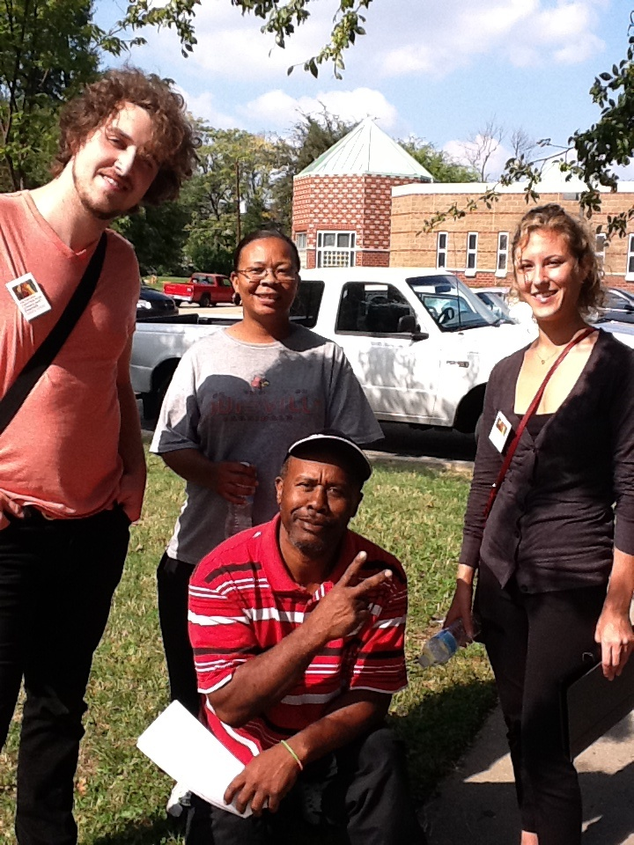
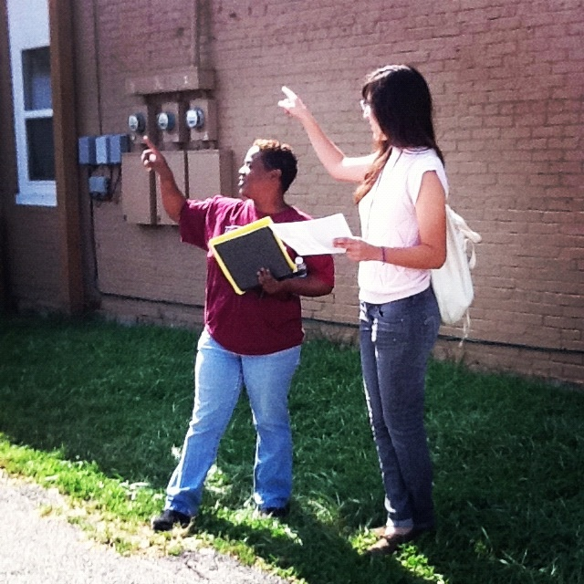
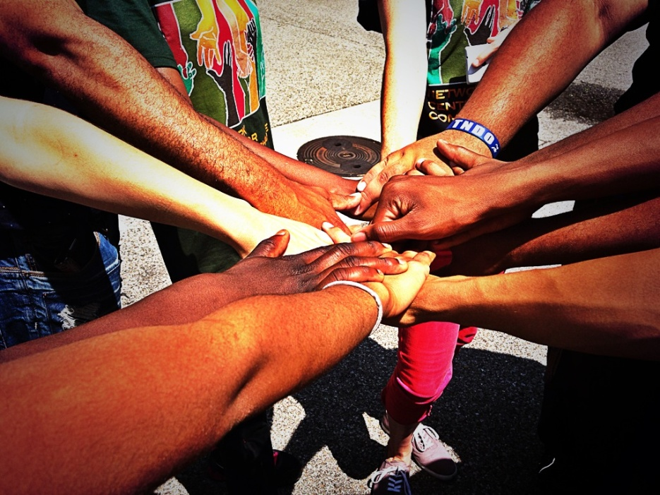

Slide 20
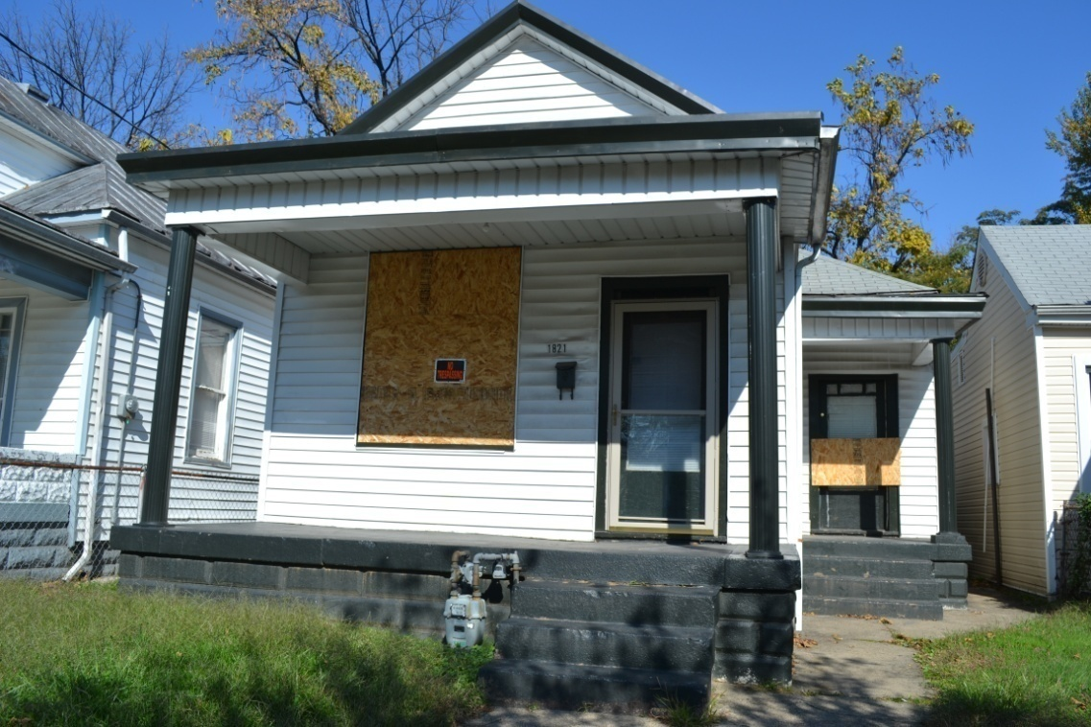
What are we tracking?
Basic housing characteristics
Occupancy status
Vacancy indicators
Roof conditions
Gutter conditions
Wall conditions
Windows and
door conditions
Lot area conditions

Slide 21
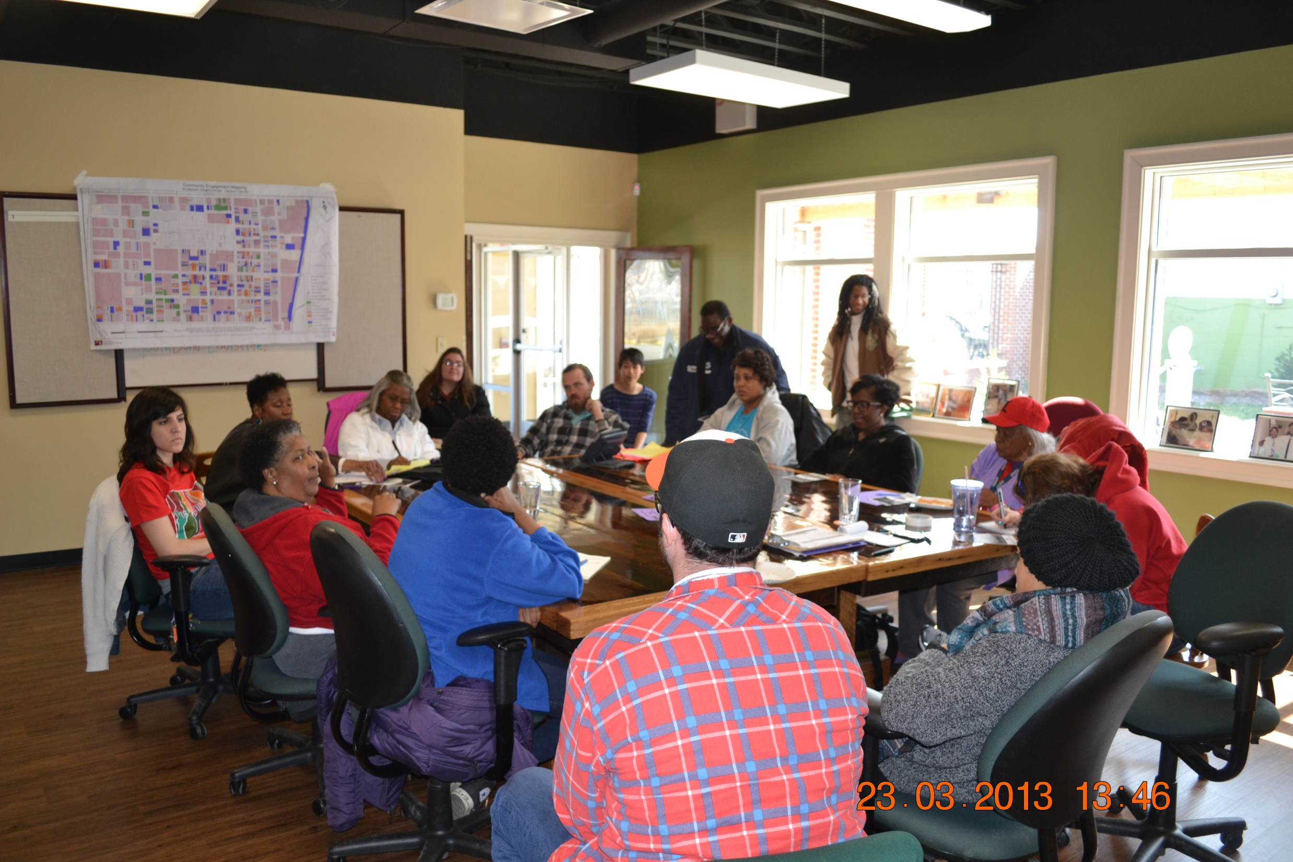

Slide 22
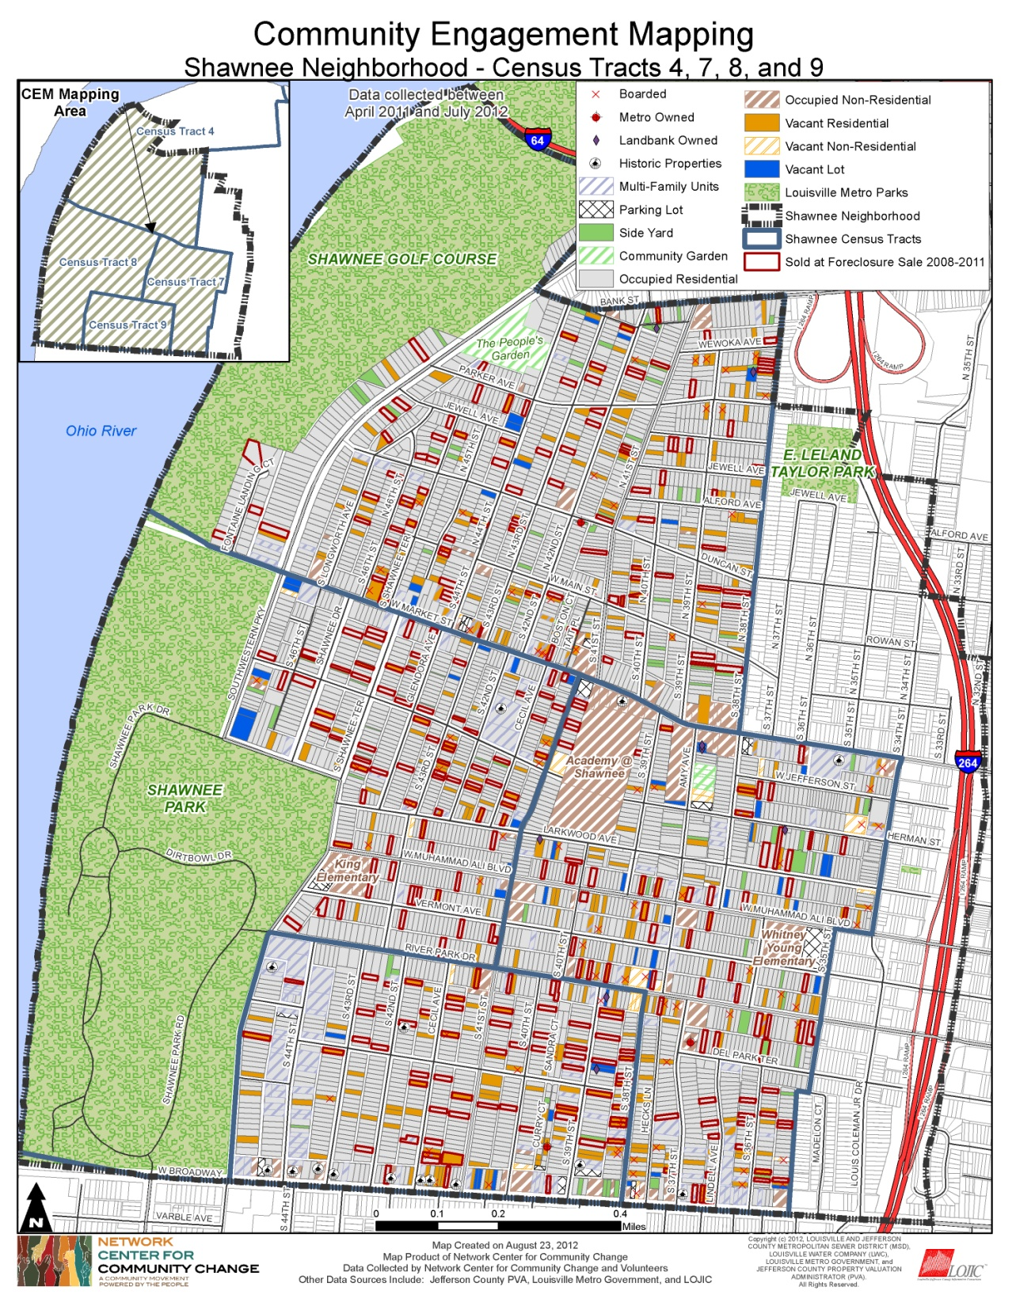

Slide 23
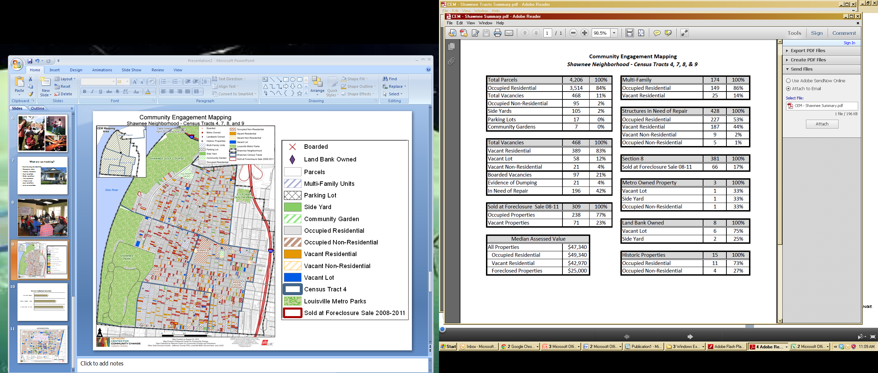

Slide 24
Some results:
Foreclosure: 309 properties or 7.75% of all residential property was foreclosed upon from 2008 – 2011. Of those 309 – 23% were vacant at the time of our map.
Vacancy: 11% of all properties were vacant. 83% of these were residencies.
Value: Median Assessed Value went down if the property was vacant. It went down more if was foreclosed upon.
Social Value: Stable, social capital, beautiful housing stock

Slide 26
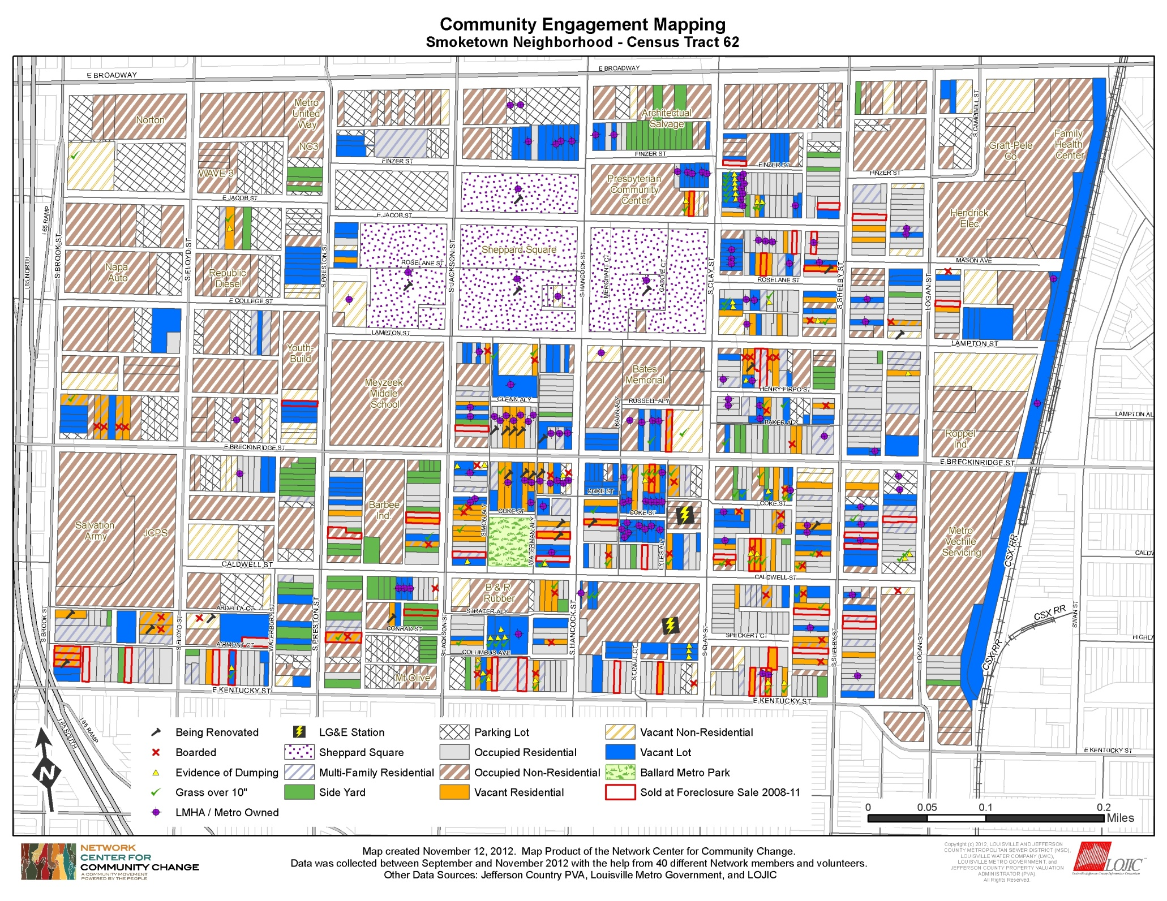
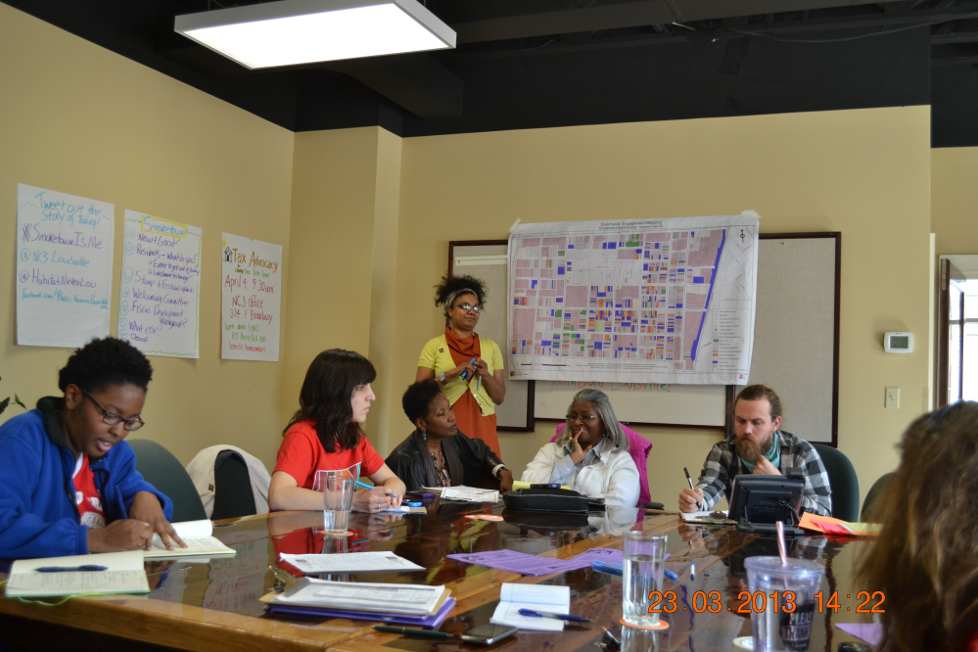

Slide 27
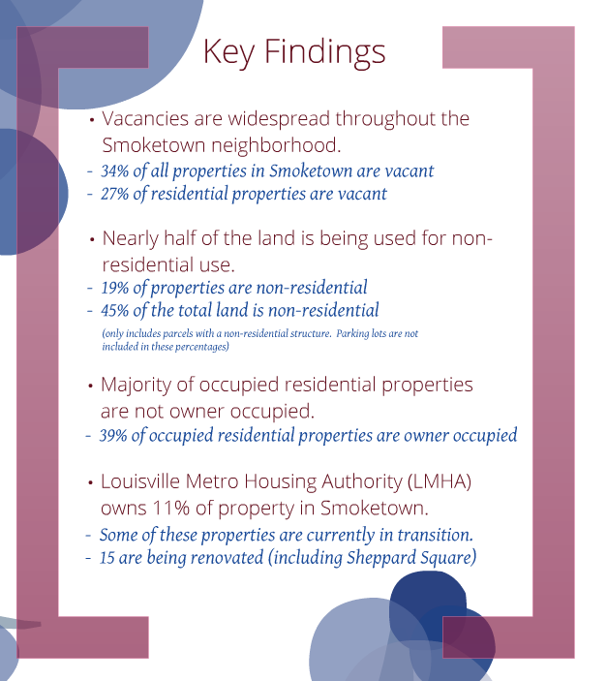

Slide 28
sources
http://factfinder2.census.gov/faces/nav/jsf/pages/index.xhtml
http://mixedmetro.com/
http://nces.ed.gov/nationsreportcard/statecomparisons/
http://nces.ed.gov/surveys/sdds/ed/index.asp?st=KY
http://www.jeffersoncountyclerk.org/delinquent-tax-lottery.asp

